Slide 1
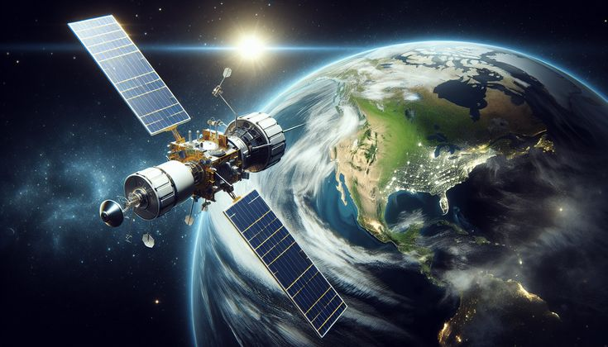


STUDY OF URBANIZATION AND ITS EFFECT OVER SILIGURI USING SATELLITE IMAGERY
Siliguri Institute Of Technology
Department : Master of Computer Application
Presented by-
Subhamay Debnath
Gayetri Sarkar

Slide 2
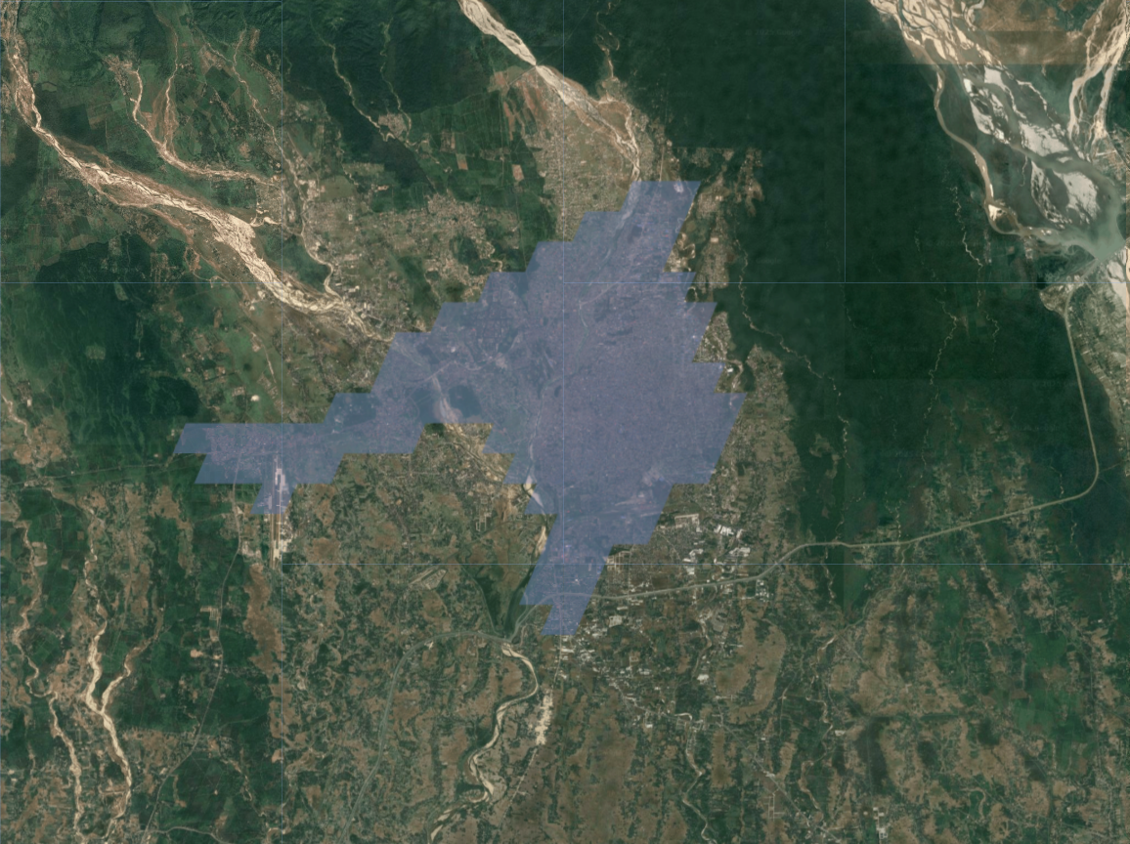
INTRODUCTION
Urbanization is rapidly transforming cities worldwide, driven by migration, economic growth, and infrastructure development.
Siliguri, the gateway to Northeast India, has seen major land use changes in recent years.
This study uses satellite imagery and Google Earth Engine (GEE) to monitor urban growth in Siliguri.
Compared to traditional ground surveys, this remote sensing method is faster, scalable, and more accurate.
The goal is to support efficient planning and promote sustainable development.

Slide 3
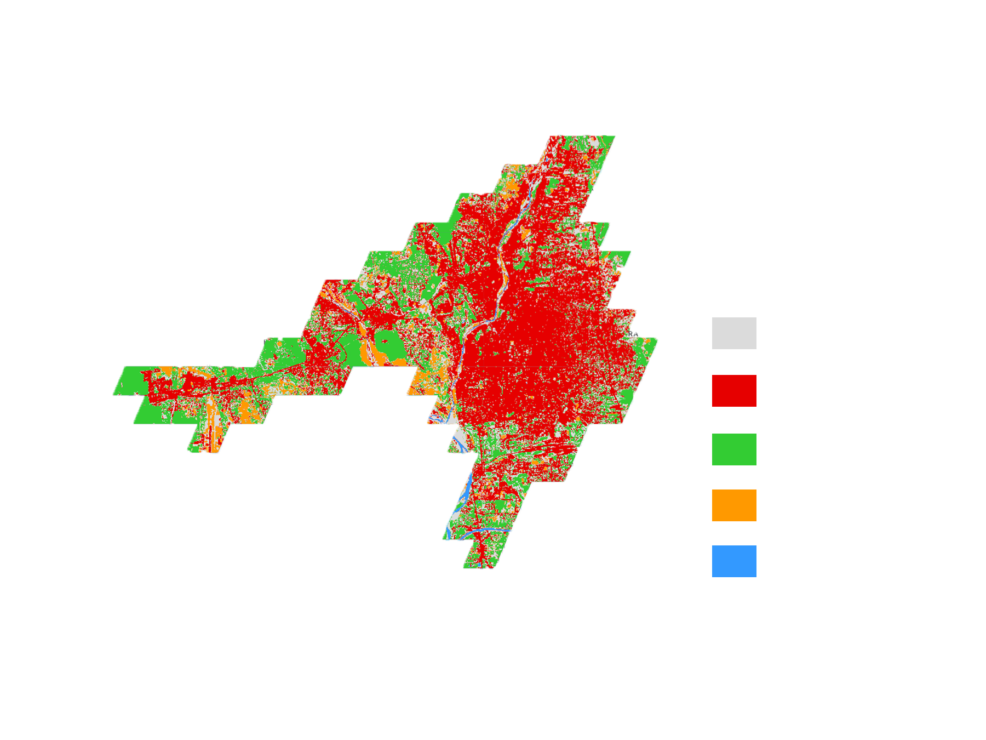
OBJECTIVE
Track urban growth in Siliguri using satellite data
Monitor land use changes from 2020 to 2024
Study the loss of greenery and water bodies
Use Google Earth Engine (GEE) and Sentinel-2 images
Create maps to show changes in city, vegetation, and water
Help in better planning and sustainable development

Slide 4
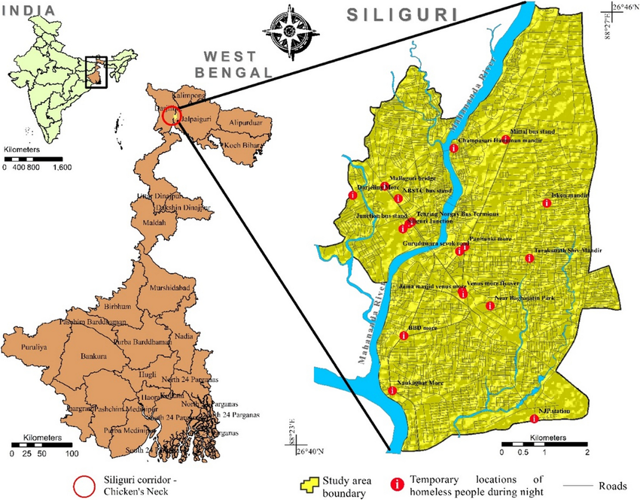
STUDY AREA – SILIGURI
Siliguri is located in northern West Bengal
Acts as a commercial hub and transport gateway to Northeast India
Rapid Urban Growth
Fast population rise
Expansion of buildings, roads, and industries

Slide 5
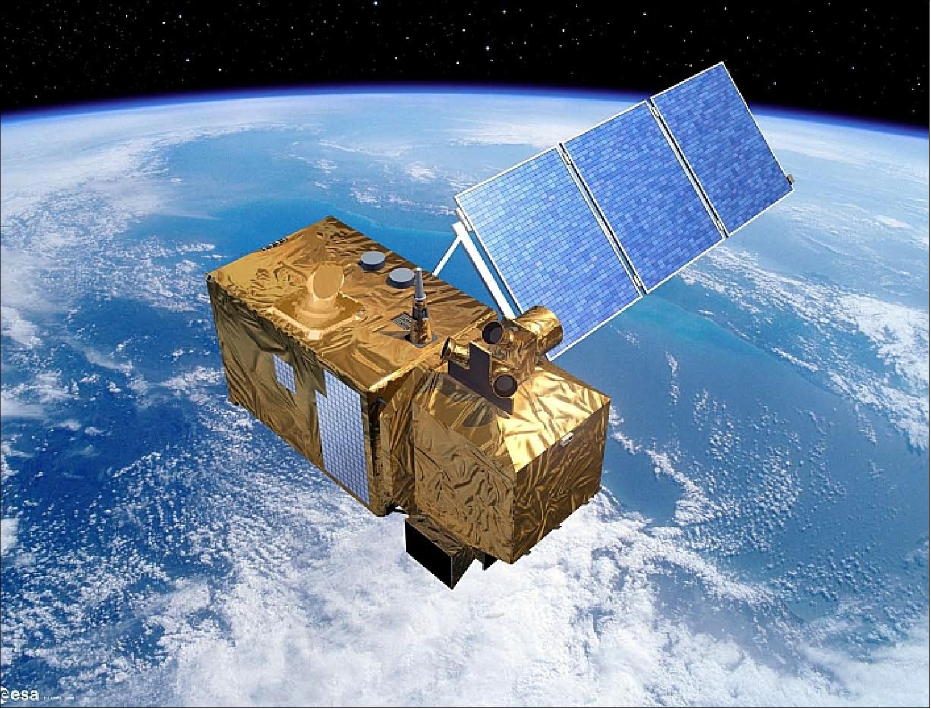
USING SATELLITE
We used Sentinel-2 satellite for monitoring.
High-resolution multispectral images
Free and regularly updated
Ideal for:
-Urban development tracking
-Green cover monitoring
-Water resource analysis
It captures visible (RGB) and invisible light (NIR, SWIR)

Slide 6
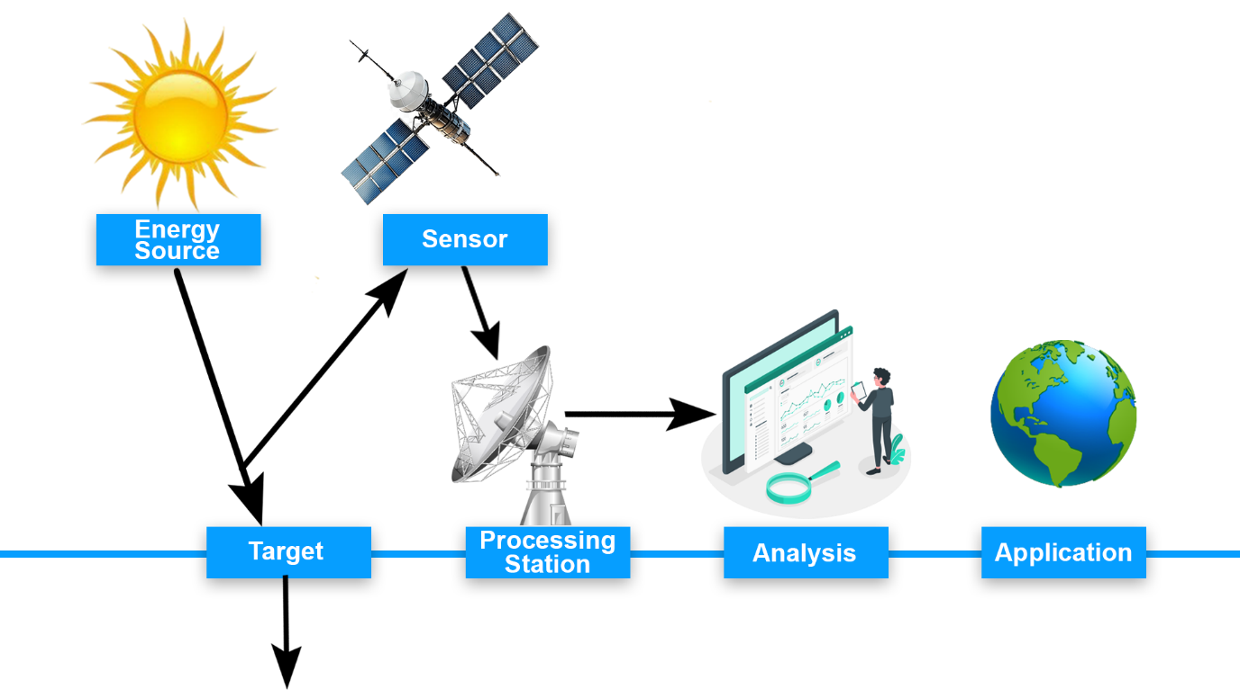
HOW SATELLITES CAPTURE EARTH'S IMAGES (REMOTE SENSING)
Energy Source: The Sun sends light energy to Earth.
Target: The Earth’s surface (buildings, trees, water, etc.) reflects this energy.
Sensor: The satellite sensor captures this reflected energy (visible + invisible light).
Processing Station: The data is sent to a ground station, cleaned, and turned into usable images.
Analysis: The images are analyzed on computers to detect changes (urban growth, vegetation loss, etc.).
Application: The results help in city planning, environment monitoring, and decision-making.

Slide 7
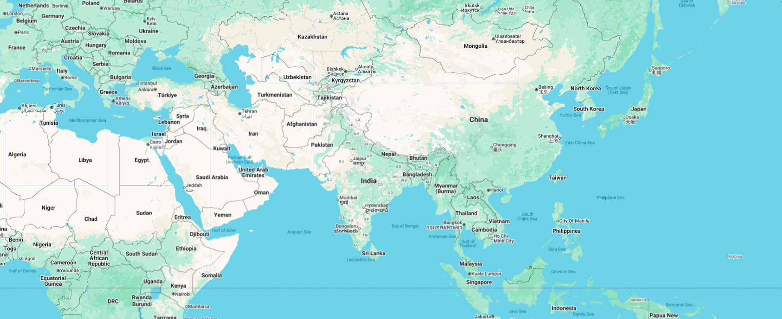
TOOLS & DATA USED
Platform:
Satellite Data:
Indices Used:
Software:
Sentinel-2 Imagery (2020–2025)
Multi-spectral images for monitoring urban, vegetation & water changes
NDVI – Detects vegetation health
NDBI – Identifies built-up/urban areas
MNDWI – Highlights water bodies
QGIS – Used for map layout, visualization & spatial analysis
Google Earth Engine (GEE)
Cloud-based platform for satellite data analysis
Used for land cover classification & change detection

Slide 8
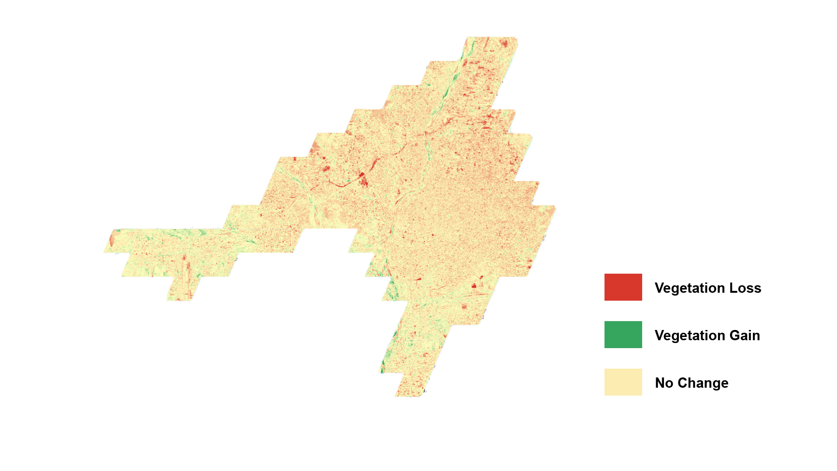

RESULTS & DISCUSSION
Urban areas increased → More buildings, less open space
Vegetation decreased → Green areas turned into concrete
Water bodies reduced → Lakes and rivers shrinking
Environmental impact → More heat, flooding, and pollution risks

Slide 9

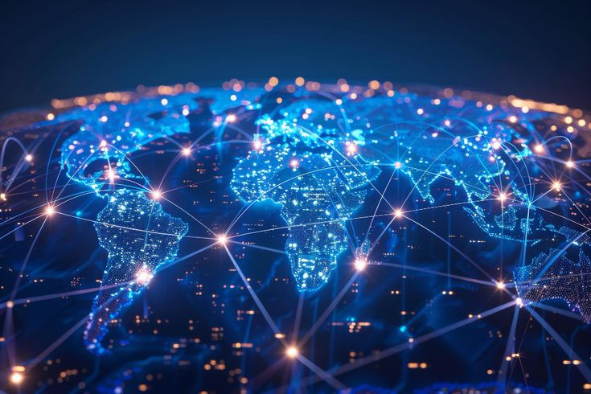
FUTURE SCOPE
Use Landsat & ALOS Add more satellite data for better accuracy and long-term tracking
Yearly Change Monitoring Track built-up, vegetation, and water changes each year
Seasonal Analysis Compare images across seasons for consistent results
Apply Deep Learning Use smart models for accurate, automated land classification

Slide 10
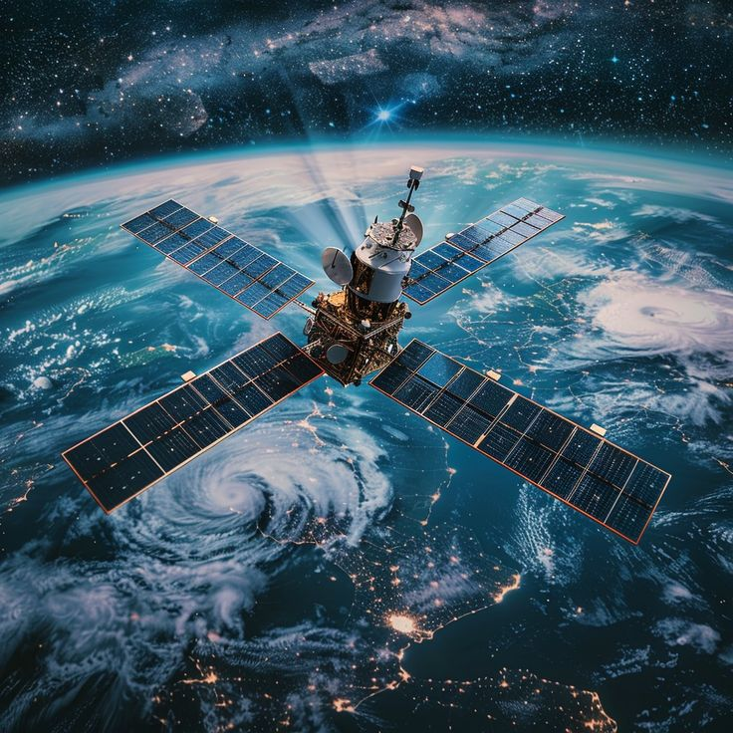
THANK YOU

